Slide 1
INTRODUCTION
Stress is a natural response to the demands and pressure of life. It can be caused by various factors such as work ,relationships , financial issues or health concerns. when we experience stress, our bodies release hormones.
That trigger a fight response, preparing us to deal with perceived threats when we experience stress, our bodies release hormones like epinephrine, cortisol ,and norepinephrine.

Slide 2
Problem statement
Design an IOT-based wearable device that can accurately detect changes in stress levels in real-time

Slide 3
EXISTING SOLUTION There are several existing solutions for stress management that you might find helpful. Some popular ones include mindfulness and meditation apps like Headspace or Calm, wearable devices like Fitbit or Apple Watch that track stress levels, and online stress management programs like Stress Scan or Stress Check. These tools offer various techniques and resources to help individuals identify and cope with stress. Remember to find the solution that works best for you and fits into your lifestyle.
proposed solution
To develop an IoT-based wearable device that incorporates sensors like the ESP8266, heart rate beat sensor, temperature sensor, and GSR sensor. By collecting data from these sensors and utilizing machine learning algorithms, the device can analyze physiological and environmental factors to determine stress levels. This information can then be displayed on an LCD screen for visual output. It's an exciting approach to stress detection that combines technology and data analysis.

Slide 4
COMPONENTS
1.ESP8266 NODEMCU :The ESP8266 NodeMCU is a versatile and affordable Wi-Fi module used for IoT projects and can be programmed using the Arduino IDE.
2.LCD DISPLAY:An LCD display can be used to provide visual output and display information in various IoT projects.
3.GSRSENSOR: A GSR sensor, also known as a galvanic skin response sensor, can be used to measure changes in skin conductance and is commonly used in stress monitoring and biofeedback applications.
4.TEMPERATURE SENSOR:A temperature sensor is used to measure and monitor changes in temperature in various applications, such as weather monitoring or HVAC systems.
5.Heart rate pulse sensor:a heart rate pulse sensor is used to measure and monitor heart rate in real-time for fitness tracking and health monitoring purposes.
6.LI-ION RECHARGEABLE BATTERY:Li-ion rechargeable batteries are commonly used in portable electronic devices like smartphones and laptops for long-lasting power and convenience.

Slide 5
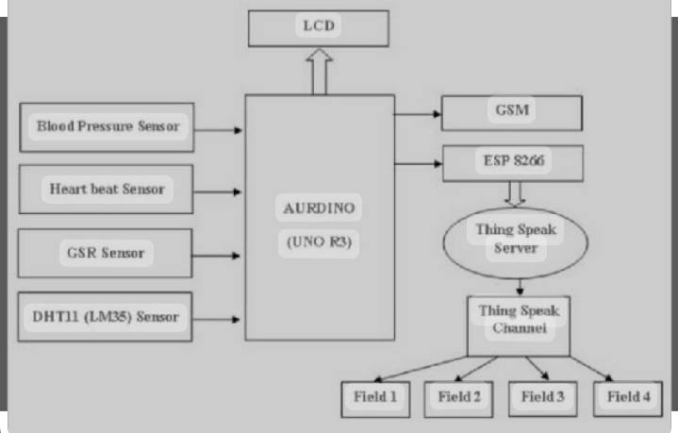
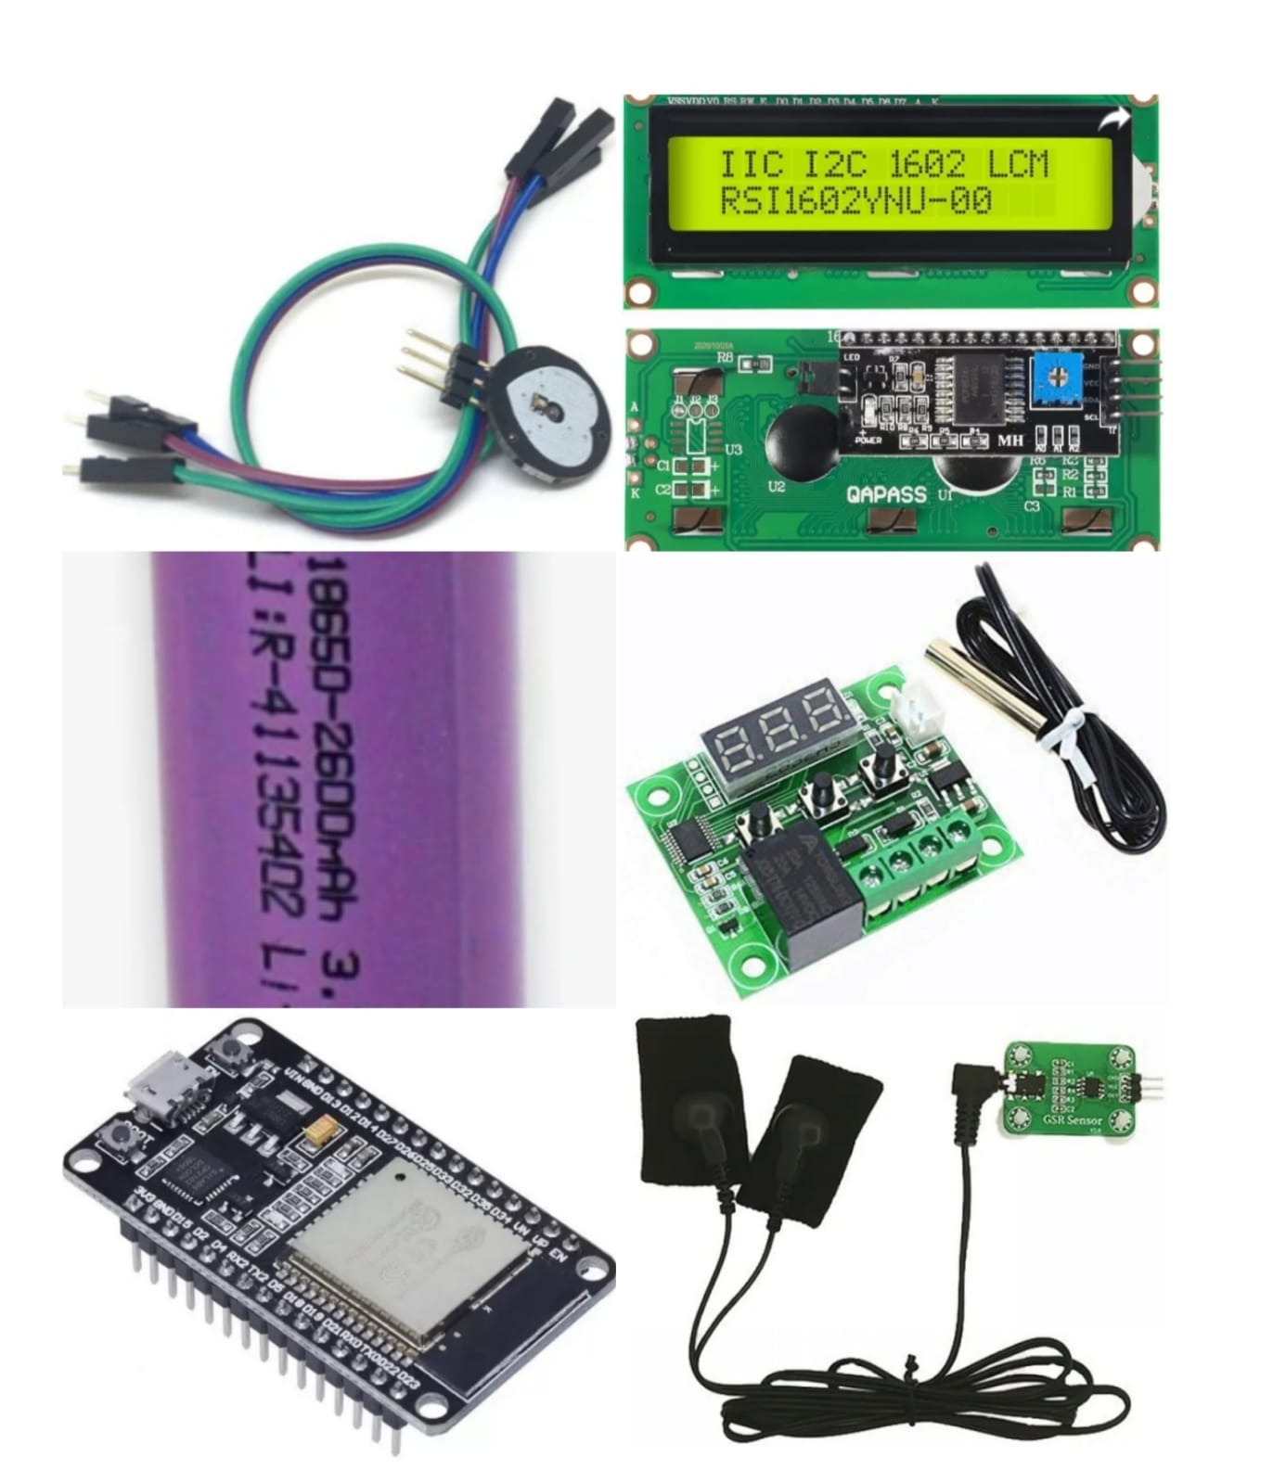
ARCHITECTURE

Slide 6
CUSTOMER SEGMENT
1.A stress monitoring system can be used by customers to track and analyze their stress levels, allowing them to better understand their triggers and manage their stress more effectively. This can lead to improved mental and physical well-being, increased productivity, and better overall quality of life.
2.The stress level readings is available in smartphones with the help of sensors.
3.It is useful for who faced stress like software employees,students ,farmers ..etcand they detect stress very easy manner using this iot sensors

Slide 7
conclusion
These wearable device provide real-time feedback and insights on stress levels, empowering individuals to take control of their health.

Slide 8
Thank you

